Slide 1
Passé Composé vs. Imparfait

Slide 2
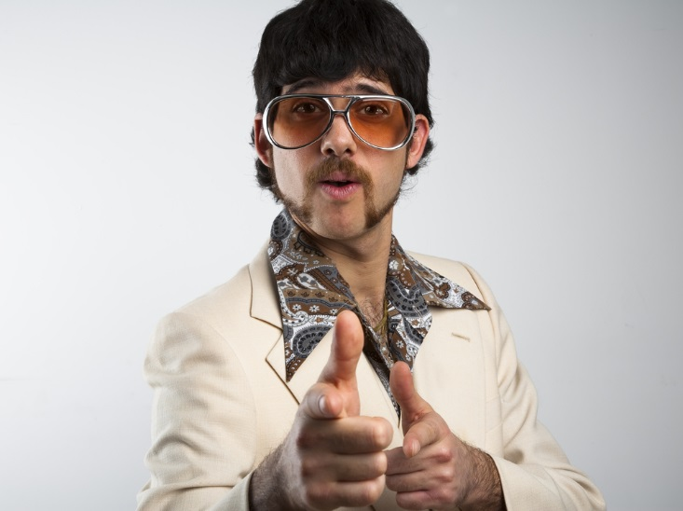
Je m’appelle Brio Hodds et j’ai un passé très intéressant
BRIO – Passé Composé
HODDS - Imparfait
B eginning
R eporting
I nterrupting
O ver and done
H abitual
O ngoing
D escription
D ate & Time
S et the scene

Slide 3
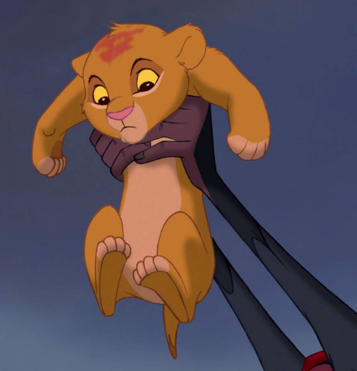
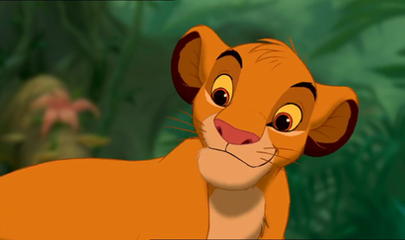
SIMBA CHEATED
SIMBA – Passé Composé
CHEATED - Imparfait
S ingle action
I nterruption
M ain event
B eginning action
A rrivals & departures
C haracteristics & descriptions
H ealth
E motion
A ge
T ime
E ndless activities
D ate

Slide 4
Pretérito vs. Imperfecto

Slide 5
Yo soy Brio Hodds y tengo un pasado muy interesante
BRIO – Pretérito
HODDS - Imperfecto
B eginning
R eporting
I nterrupting
O ver and done
H abitual
O ngoing
D escription
D ate & Time
S et the scene

Slide 6
SIMBA CHEATED
SIMBA – Pretérito
CHEATED - Imperfecto
S ingle action
I nterruption
M ain event
B eginning action
A rrivals & departures
C haracteristics & descriptions
H ealth
E motion
A ge
T ime
E ndless activities
D ate

